Slide 1

TCP-IP:

Slide 2
Chapter Objectives
Explain TCP and IP
Explain the functions of different protocols in TCP/IP protocol suite
Explain the difference between TCP and UDP
Configure a PC using TCP/IP configuration

Slide 3
Recall Questions for GD
What is an IP address?
List different types of IP address.
List different Classful IP addresses.

Slide 4
TCP/IP
Two layer communication protocol used by Internet
TCP provides connection-oriented reliable transport service
Divides the message into smaller packets called segments
IP is a connectionless and unreliable datagram protocol and provides no error checking
IP transfers data in the form of packets called datagrams

Slide 5
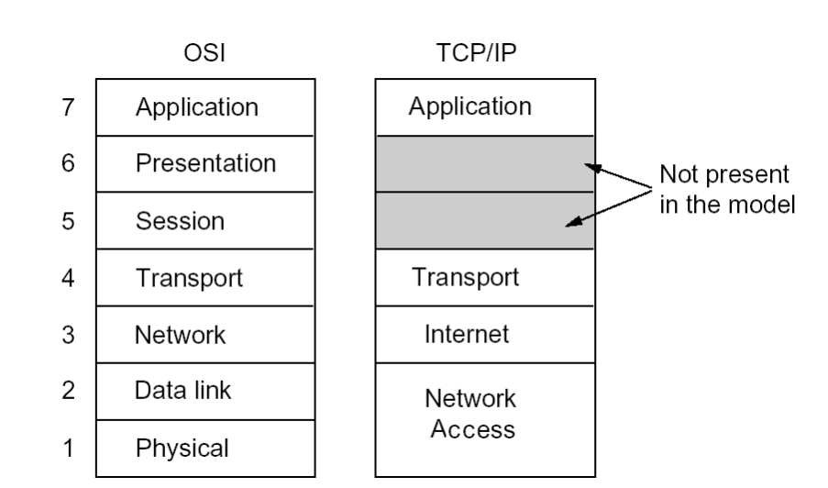
TCP/IP Protocol Suite
Designed before OSI model
Also referred to as the Internet protocol suite
Consists of four layers
Provides independent protocols at each layer

Slide 6
Network Access Layer - I
Lowest layer of the TCP/IP protocol stack
Contains two sublayers, the media access control (MAC) sublayer and the physical sublayer.
MAC sublayer aligns closely with the data link layer of the OSI model, and is sometimes referred to by that name.
Physical sublayer aligns with the physical layer of the OSI model.

Slide 7
Question Time Limit – 3 Mins
List the layers of TCP/IP Protocol suite.

Slide 8
Network Access Layer - II
Some references divide the TCP/IP model into 5 layers, with the MAC and physical layers occupying the lowest two layers.
TCP/IP does not define any particular protocol at this layer.
Standard and proprietary protocols are supported by this layer.
Proprietary protocols are the protocols which are kept secret from the public.

Slide 9
Internet Layer
Internet layer of the TCP/IP model maps to the network layer of the OSI model that’s why it is sometimes referred to as the network layer.
TCP/IP supports the Internetworking Protocol (IP) at the internet layer.
IP uses four supporting protocols that are ARP, RARP, ICMP and IGMP.

Slide 10
IP (Internetworking Protocol)
IP is a transmission mechanism used by the TCP/IP protocol.
Is a connectionless and unreliable datagram protocol and provides no error checking.
Transfers data in the form of packets called datagrams.
Datagrams can travel through various routes to reach the destination and may not arrive in the order in which they were sent.
IP does not reorder the data once they reach the destination.
Also, IP does not keep a track of the routes of the datagram.

Slide 11
ARP (Address Resolution Protocol) and RARP (Reverse ARP)
Used to determine the physical address (MAC Address) of the device only when its IP address is known.
Used to translate the IP addresses to Ethernet MAC Addresses.
ARP is used to associate an IP address with the physical address.
RARP is used to determine the IP address of the host only when the MAC Address is known.
It is useful when the computer is connected to the network for the first time.

Slide 12
Practical - I
Perform activity mentioned in Lab no. 1 at the end of this chapter.
  To see the various host addresses in the network using ARP command.

Slide 13
ICMP (Internet Control MessageProtocol)
Used by computer and gateways to send notification of datagram problems such as query and error reporting messages back to the sending device.
Its only function is to report problems to the original sender not to correct them.
Ping command is an example of ICMP protocol.
Ping command is used to check your network connection.

Slide 14
IGMP (Internet Group Message Protocol)
Used for multicasting means to transmit message to multiple recipients at the same time.
Class D IP address is used for this protocol.

Slide 15
Question Time Limit – 3 Mins
List the protocols used in Internet layer of TCP/IP protocol suite.

Slide 16
Transport Layer
At the transport layer, the TCP/IP defines the TCP and UDP protocols.
These two protocols are responsible for delivering messages from a running process to other process, whereas IP delivers the packet from one physical device to another.

Slide 17
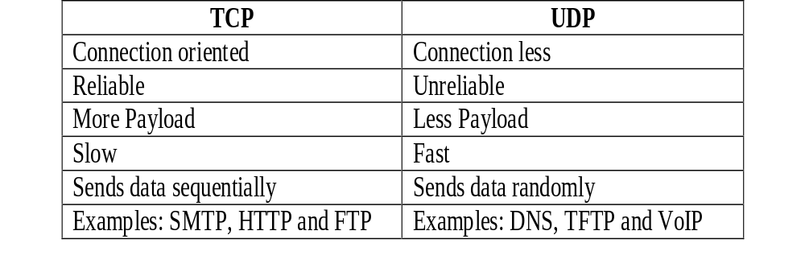
Difference between TCP and UDP

Slide 18
SCTP (Stream Control Transmission Protocol)
  Reliable and connection-oriented transport protocol that offers acknowledged, error-free and non-duplicated transmission of multiple streams of data.
  Multiple streams of data can be transmitted simultaneously.
  Used over wireless network and transmission of multimedia data.
  Supports voice over IP and combines the best features of TCP and UDP

Slide 19
Application Layer - I
Application layer of the TCP/IP model corresponds to the application layer of the OSI reference model.
Many protocols such as SMTP, FTP, DNS, SNMP, NFS, and TFTP are defined at this layer.

Slide 20
Question Time Limit – 2 Mins
List the protocols used in transport layer of TCP/IP protocol suite.

Slide 21
Application Layer - II
Simple Mail Transfer Protocol (SMTP)
Used to transfer e-mail messages across the network and the Internet.
Helps in sending messages such as text or message with an attachment to single or multiple recipients.
File Transfer Protocol (FTP)
Used to exchange files from one host to another connected over the Internet. Server and client are involved in the process of transferring file.

Slide 22
Application Layer - III
Domain Name System (DNS)
Used to store and resolve the Internet domain names of hosts to IP addresses.
Simple Network Management Protocol (SNMP)
Used to manage and control network devices, performance and security of the network.
It is based on the client-server model.

Slide 23
Application Layer - IV
Network File System (NFS)
Allows computers on different operating systems e.g. Windows and Unix to share files and disk storage.
Trivial File Transfer Protocol (TFTP)
Uses UDP to upload or download files.
Is a simple form of FTP and does not provide security features.

Slide 24
Port Number
Used to identify a specific process to which an Internet or other network message is to be forwarded when it arrives at a server.
Well known ports are assigned by IANA (Internet Assigned Numbers Authority) e.g.
FTP – 21
Telnet – 23
SMTP – 25
POP - 110

Slide 25
Question for GD Time Limit – 3 Mins
List the protocols used in application layer of TCP/IP protocol suite.

Slide 26
TCP/IP Configuration
There are some basic TCP/IP configuration parameters.
The users should be familiar with TCP/IP parameters before configuring TCP/IP and connecting to Internet like:
host name,
DHCP client,
IP address,
domain name,
broadcast address,
default gateway

Slide 27
Question Time Limit – 3 Mins
What is a port number? Mention the port number for ftp and telnet.

Slide 28
Host name
Individual computer names are called as host names in a network.
Some applications such as e-mail, uses host name to identify the destination to which the packet has to be sent.
Host name is made up of upper case, lowercase letters (A – Z, a – z), hyphen (-) and numbers (0 – 9) e.g. Accounts-PC1.
Begins with a letter and is not longer than sixty three characters.
Host name for a system is unique on a network.

Slide 29
Domain name
Is not a single computer, but a holding space into which computer names can be added.
Individual computer names in the DNS (Domain Name System) naming convention are commonly called as host names.
Characters for domain names are limited to uppercase and lowercase letters (A-Z, a-z), numbers (0-9), and the hyphen (-). No other characters are used.
A domain name is a unique name for example, xyz.com.

Slide 30
IP Address
No two systems on the same network share the same IP address; if two machines accidentally receive the same address, “IP address conflict” error will occur.
These IP addresses need to be configured in the machines.
These numbers are typed into each system manually, but most IP networks can take advantage of Dynamic Host Configuration Protocol (DHCP) to configure these values automatically on each computer.

Slide 31
DHCP Client
Dynamic Host Configuration Protocol (DHCP) is a TCP/IP service protocol.
DHCP provides secure, reliable TCP/IP network configuration, prevents address conflicts, and helps conserve the use of client IP addresses on the network.
DHCP enables individual client machines on a network to configure all of their IP settings (IP address, subnet mask, DNS) automatically.
DHCP server stores all of the necessary IP information for the network, and provides that information to clients as they boot into the network.

Slide 32
Default Router
Is the default gateway used by the host to access hosts on other networks.
In a TCP/IP network, the nearest router to a particular host is known as default router.
This router’s IP address is part of the necessary TCP/IP configuration used for communicating with another network as well.
If a system wants to send data to a system on another network, a local network must connect via a router.
This router is called as the default gateway, gateway router, or even gateway.

Slide 33
DNS Server
Domain Name System (DNS) is used to manage the names of Web sites and other Internet domains.
DNS allows you to type names into your Web browser like www.jetkinginfotrain.com and your computer to automatically find that address on the Internet.
A key element of the DNS is a worldwide collection of DNS servers.

Slide 34
Broadcast Address
A broadcast is a packet addressed to all machines. In TCP/IP, the general broadcast address is 255.255.255.255.
In data link layer, the address FF-FF-FF-FF-FF-FF a NIC attaches to a frame when it sends a broadcast to every other NIC on the network.

Slide 35
Question Time Limit – 3 Mins
List the TCP/IP configuration parameters.

Slide 36
Practical - II
Perform activity mentioned in Lab no.2 at the end of this chapter.
  To configure TCP/IP settings in a PC to communicate with Internet.

Slide 37
Testing a Network
To check that whether you have configured TCP/IP settings in a PC properly and you can connect to any PC or access any website, follow the steps as mentioned below:
  First, ping to the gateway. If ping is not successful then the problem is related to LAN.
  Then ping to the external DNS server (if any). If ping is not successful then the problem is related to WAN.
  Check the response time to know your network’s speed.

Slide 38
Practical - III
Perform activity mentioned in Lab no. 3 at the end of this chapter.
  To test a network using ping command.

Slide 39
Summary - I
Network protocols are the set of predefined rules, used by the devices connected to network to communicate with each other.
The TCP/IP protocol suite, also referred to as the Internet protocol suite, is the set of communications protocols that implements the protocol stack on which the Internet and most commercial networks run.
Four layers of TCP/IP protocol suite are:
  Network Access

Slide 40
Summary - II
  Internet
  Transport
  Application
The network access layer contains two sublayers, the media access control (MAC) sublayer and the physical sublayer.
Internet layer uses IP and IP uses four supporting protocols that are ARP, RARP, ICMP and IGMP.
At the transport layer, the TCP/IP defines the TCP and UDP protocols.

Slide 41
Summary - III
Many protocols such as SMTP, FTP, DNS, SNMP, NFS, and TFTP are defined at application layer.
A port number is a way to identify a specific process to which an Internet or other network message is to be forwarded when it arrives at a server.
The users should be familiar with TCP/IP parameters like host name, DHCP client, IP address, domain name, broadcast address, default gateway before configuring TCP/IP and connecting to Internet.

Slide 42
Mind Map
Draw a mind map to summarize the session.

